Slide 1
Election Forecasting with Online Polling Data
Evidence from Dalia Europulse Survey
Alexander Sacharow | Moritz Hemmerlein
October 10, 2017

Slide 2
Outline
Intro to Election Forecasting: Methods
State of the Art Polling
Employing Dalia Data: Our Methodology
Our Forecasts
Take Aways

Slide 3
Election Forecasting: Methods
Start: Forecast methods: (Slide Nr 1)
fundamentals, (Gschwend, Norpoth 2010, Lauderdale Linzer 2015)
pooling,
Markets/competition/wisdom of the crowd, (e.g. Rothschild 2009, Murr 2011)
digital trace models, (e.g. Swearingen et al 2014)
hybrid models (Zweitstimme.org)
combining forecast (poolin the polls; Jackman 2005)
Fundamentals models
Survey-based modeling
Prediction markets/Wisdom of the crowd
Digital trace models
Hybrid models
Combining forecasts/Pooling the polls

Slide 4
Polling: State of the art
Pros
most popular method
polls as natural by-product of campaigns
incorporation of effects of campaign events
dynamic forecasts possible → horserace journalism
high face validity; predictor and outcome closely related
Cons
campaign noise (Gelman/King 1993) → are observed shifts substantive?
what’s the point of dynamic forecasts of a singular event?
survey institutes as black boxes → polling failures
specification of uncertainty?
no substantive theoretical value; almost tautological models
State of the Art pooling / paper review (slides 2-3)
Pros and cons
z.B polls schlechter 3 monate vor election
Campaign noise/horse race journalism
Attitudinal effects of polls (paper? Vorletzte oder letzte Vorlesung 08/09)
Ende/Papers/Quellen

Slide 5
Polling: State of the art

Slide 6
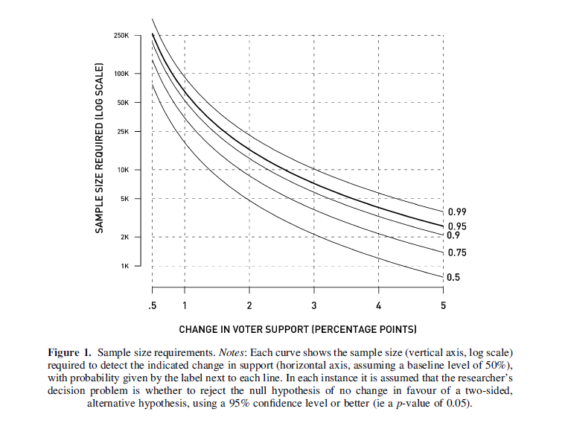

Polling: State of the art
-> Come up here with different polling problems/observations
z.B polls schlechter 3 monate vor election
Campaign noise/horse race journalism
Attitudinal effects of polls (paper? Vorletzte oder letzte Vorlesung 08/09)

Slide 7
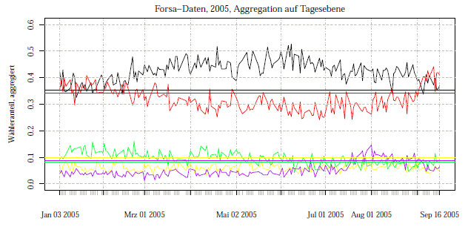
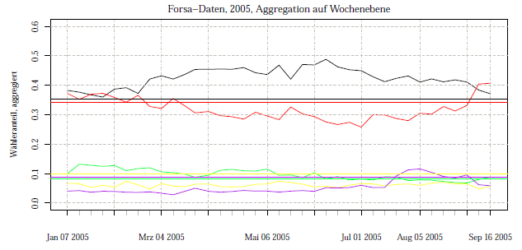
Polling: State of the art
-> Come up here with different polling problems/observations
z.B polls schlechter 3 monate vor election
Campaign noise/horse race journalism
Attitudinal effects of polls (paper? Vorletzte oder letzte Vorlesung 08/09)

Slide 8
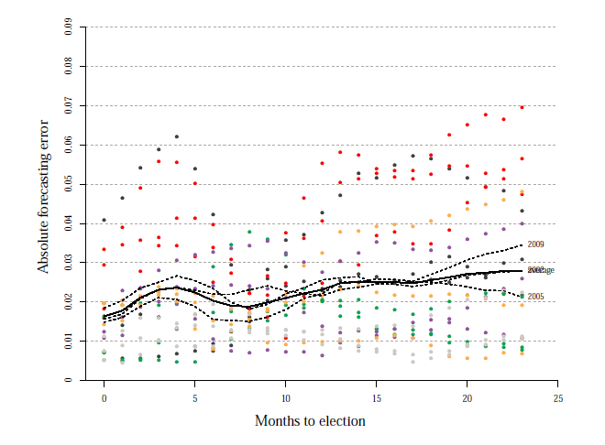
Polling: State of the art

Slide 9
Polling: Polling the Polls
Considerations
poll variation over time
poll variation across polling organizations (“house effects”)
single polls hardly informative
Approach
pool polls (more data, more precision)
smooth over time (intentions less variable than poll variability suggests)
correct for house-specific bias

Slide 10
Polling: Non-representative polls
Considerations
decreasing response rates
realized samples are biased
Approach
realize (massive) non-representative poll
collect predictive demographic dimensions (sex, race, age, education, state, party ID, ideology, previous vote)
statistically adjust for bias using multilevel-regression with poststratification (MRP)

Slide 11
Adjusting Europulse Data: Methodology
Vorstellung unserer Arbeit/Methodology
Methodology: Online polling with post-stratification as a solution
Results (Grafiken)
Take aways

Slide 12
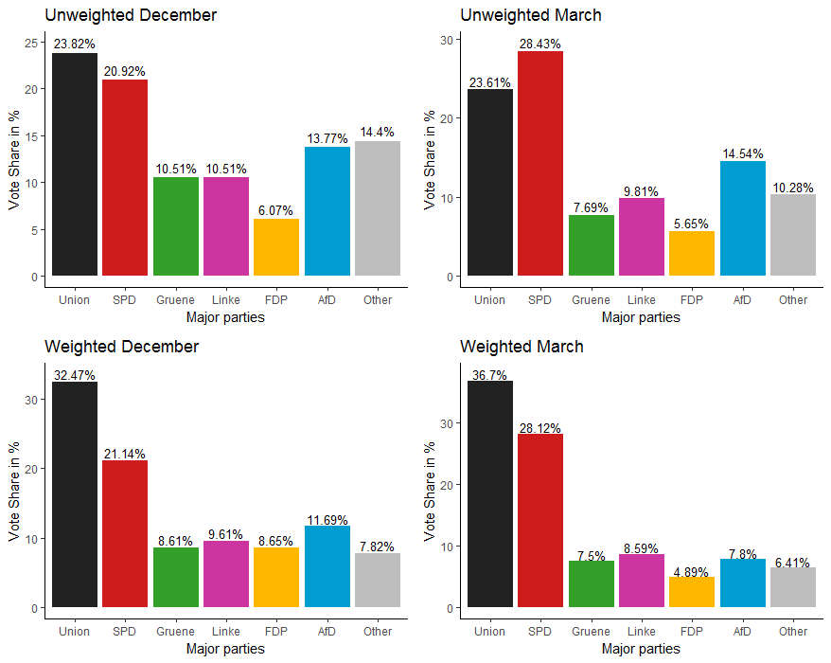
Adjusting Europulse Data: Results

Slide 13
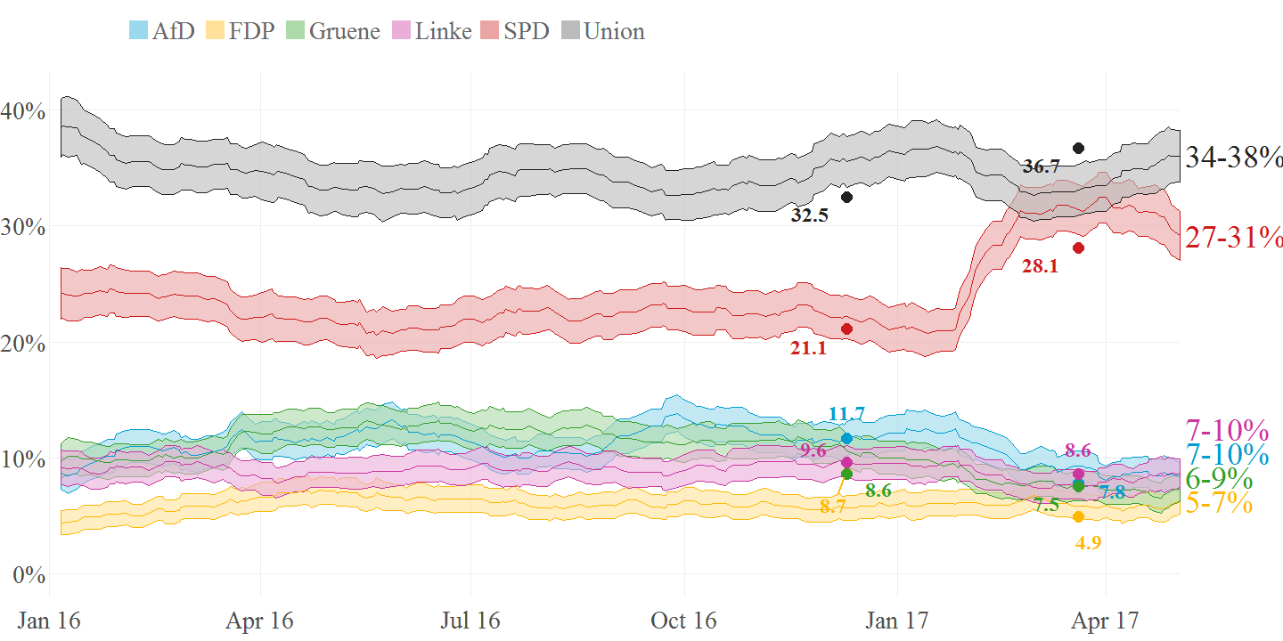
Adjusting Europulse Data: Results

Slide 14
Adjusting Europulse Data: Take aways
Insights
Shortcomings and problems
Room for improvement
Potential: What Dalia could do with the Data to become reasonable polling institution

Slide 15
Papers and Sources

